Slide 1

Internship project proposal
Gene expression changes caused by pre-eclampsia in the cerebral cortex
Ioana Weber ● 24th of July 2024

Slide 2



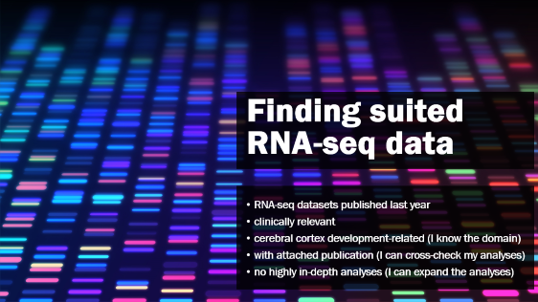




On today’s menu

Slide 3

Finding suited RNA-seq data
RNA-seq datasets published last year
clinically relevant
cerebral cortex development-related (I know the domain)
with attached publication (I can cross-check my analyses)
no highly in-depth analyses (I can expand the analyses)

Slide 4
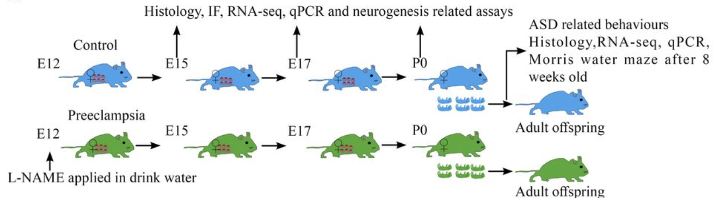
“Preeclampsia promotes autism in offspring via maternal inflammation and fetal NFκB signaling”
Liu et al., 2023, Life Science Alliance; data available in GEO database at NCBI, GSE167193
pre-eclampsia mouse model - induced in pregnant mice by treating them with a compound called L-NAME → hypertension, kidney dysfunction, abnormal placental development
offspring of these mothers behaved in ways reminiscent of ASD and scored accordingly on several behavioral tests
sequenced RNAs from the cortices of mouse embryos at day E 17.5, two days before birth, from mother animals that had or did not have their blood pressure elevated by L-NAME. Also: hippocampi of adult offspring (ASD genes)

Slide 5
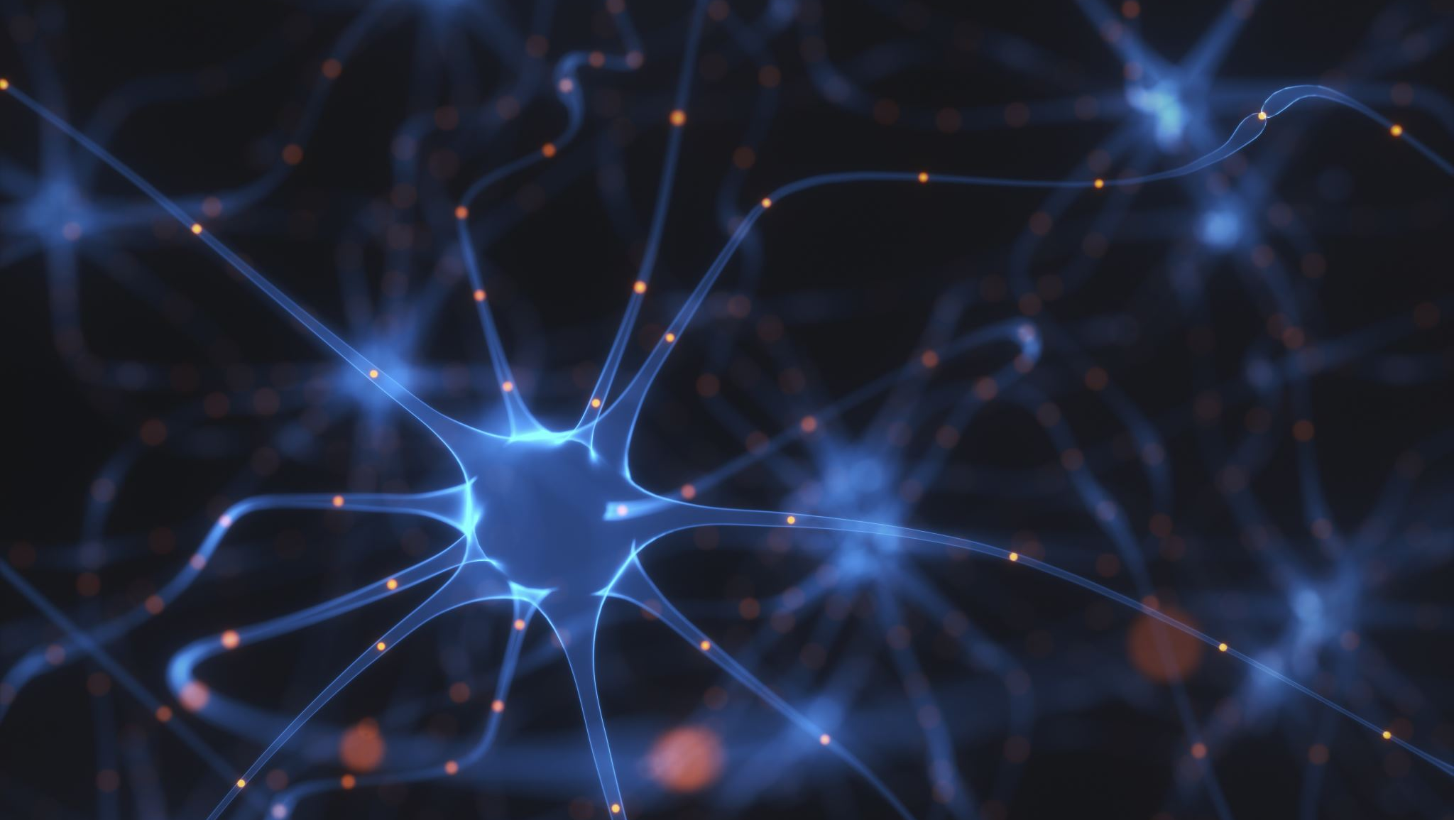
Results of original study

Slide 6
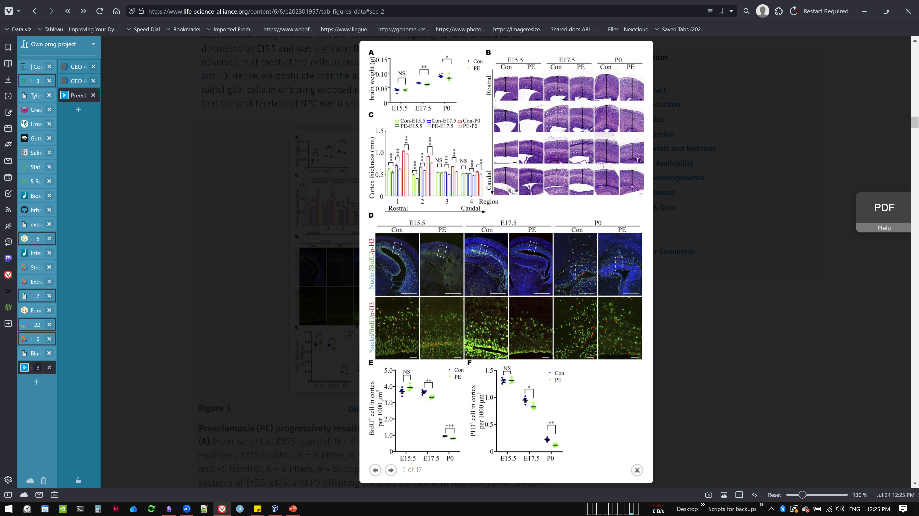
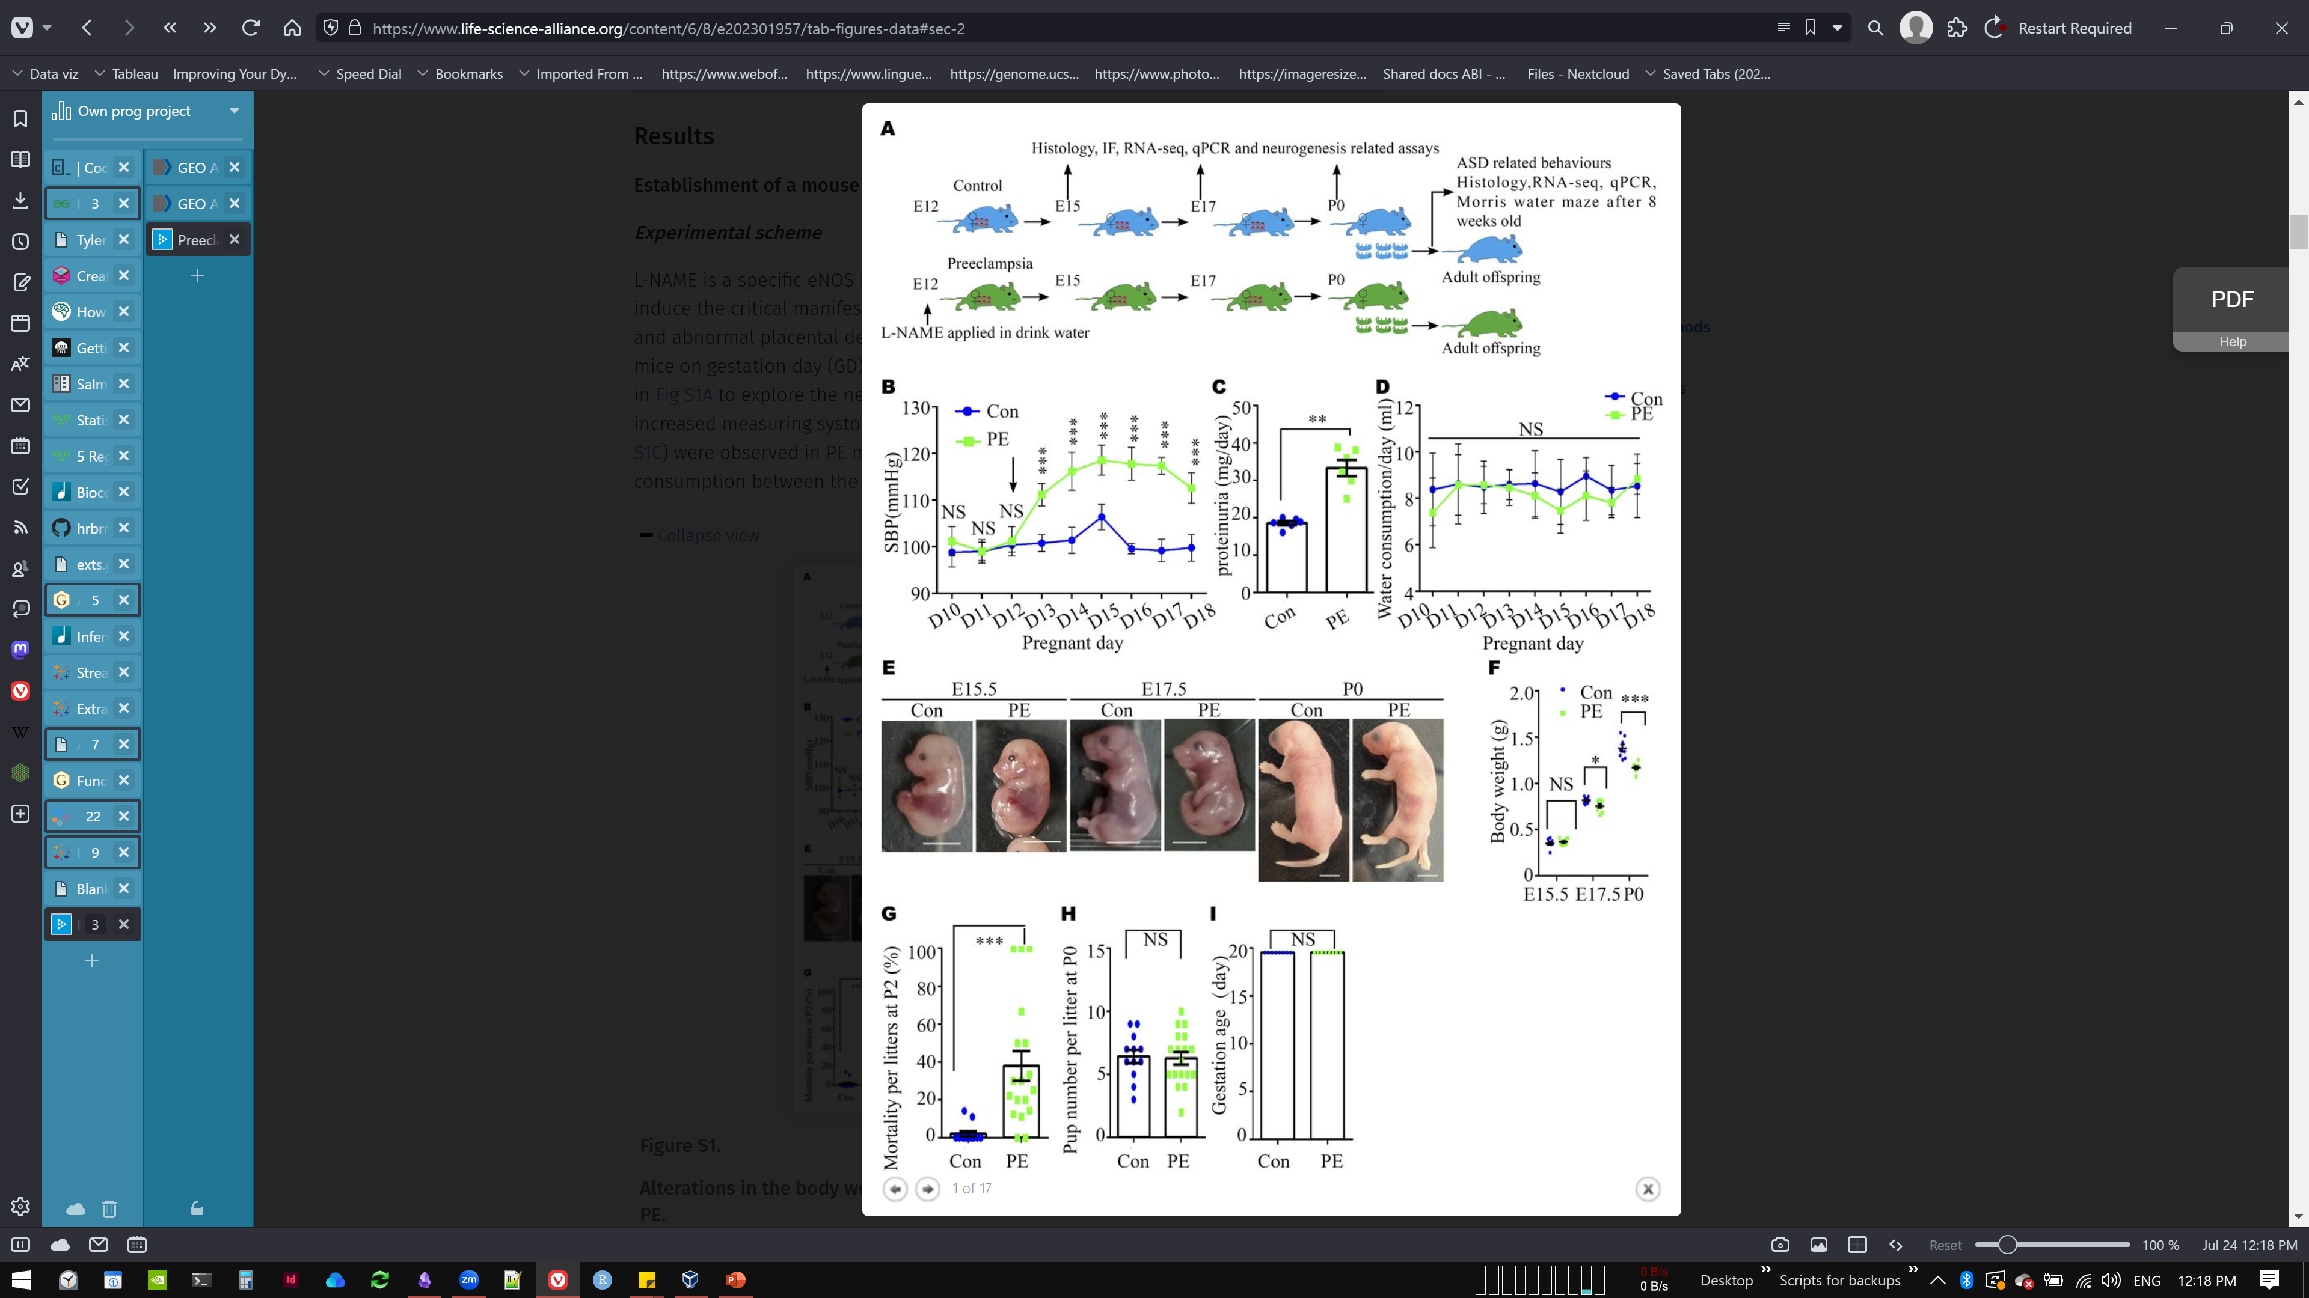
Pre-eclampsia (PE) pups are smaller, more likely to die after birth, and have thinner cortices
Potential cause:
impaired proliferation of cortex stem cells → impaired neuron generation

Slide 7
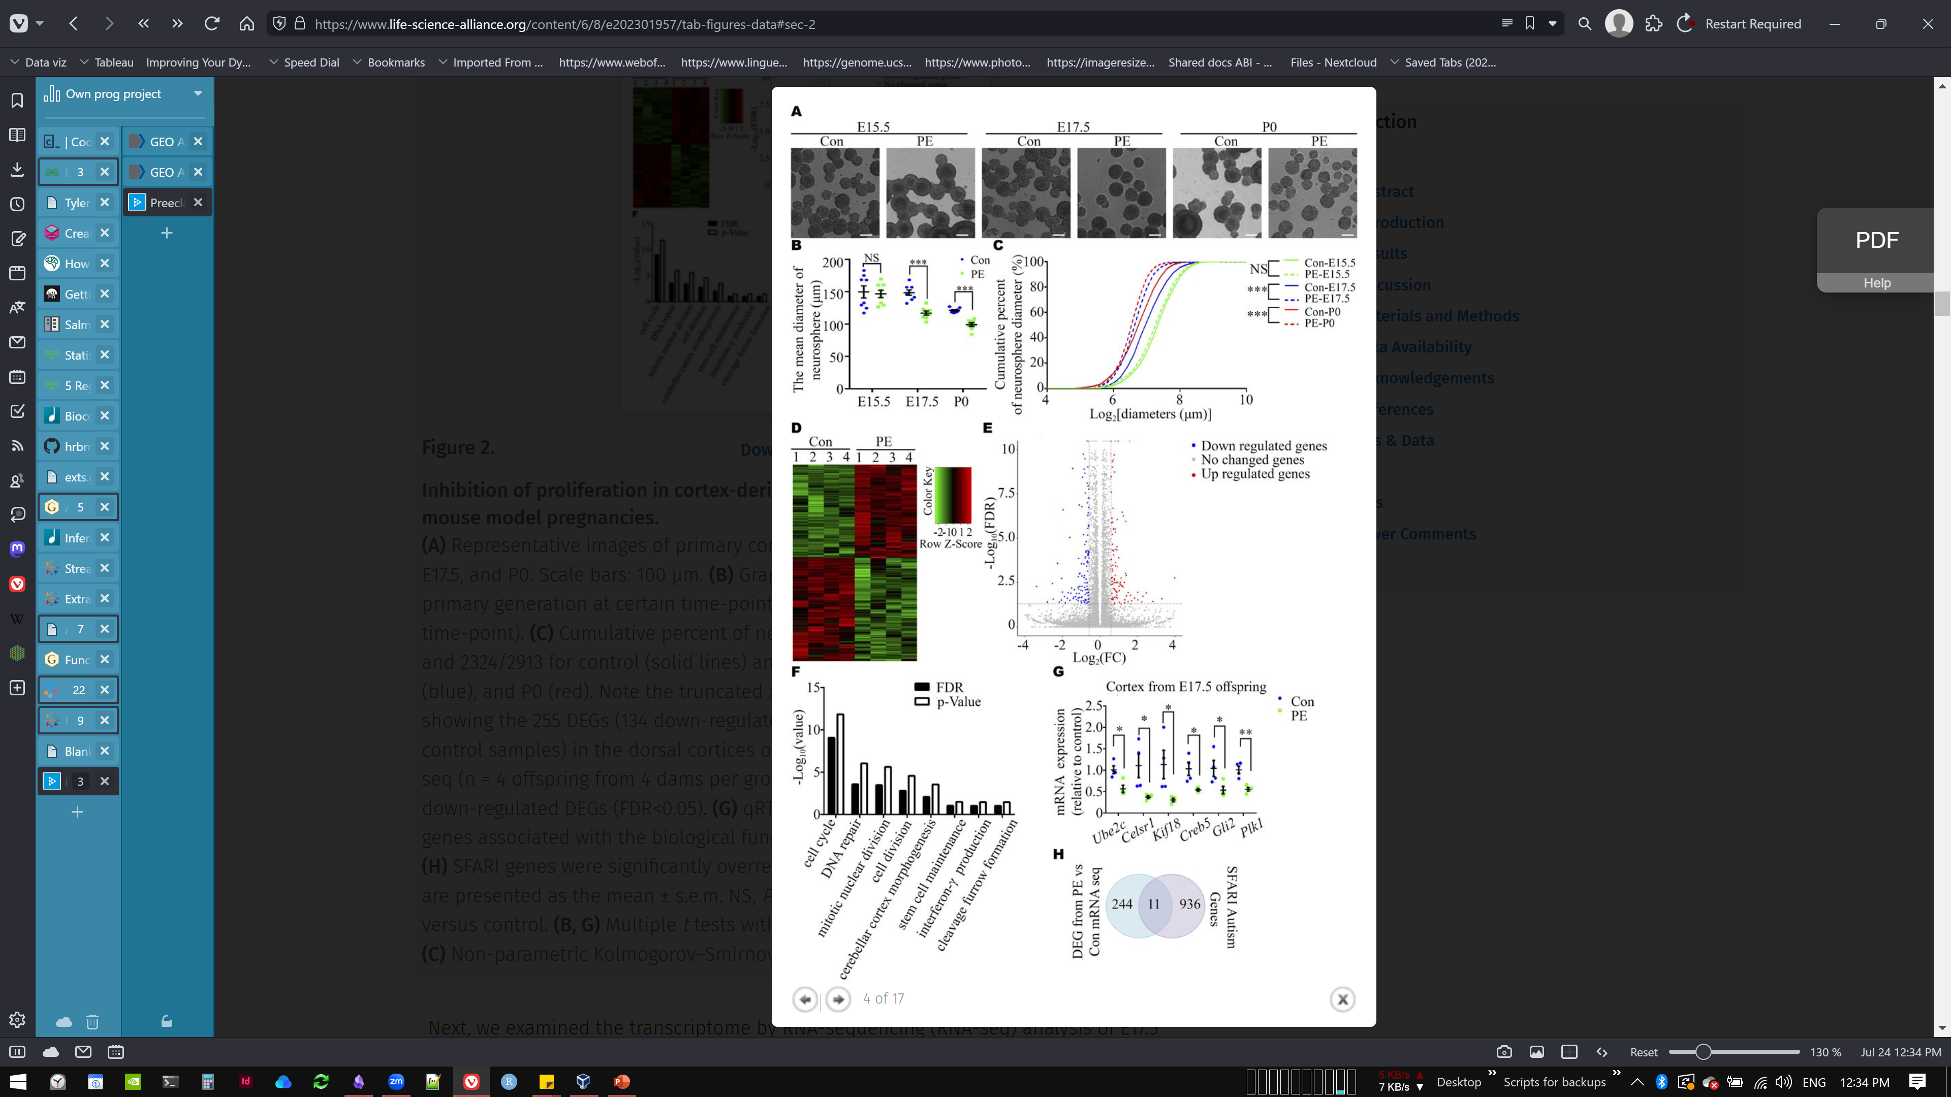
E 17.5 PE pups have differentially expressed genes (DEGs) in their cortices that could explain proliferation differences
255 DEGs:
- 134 down-regulated
+ 121 up-regulated,
compared to control samples
DEGs cluster primarily by functions related to cell division
Andreas’s question: are any of the DEGs also related to cell death?

Slide 8
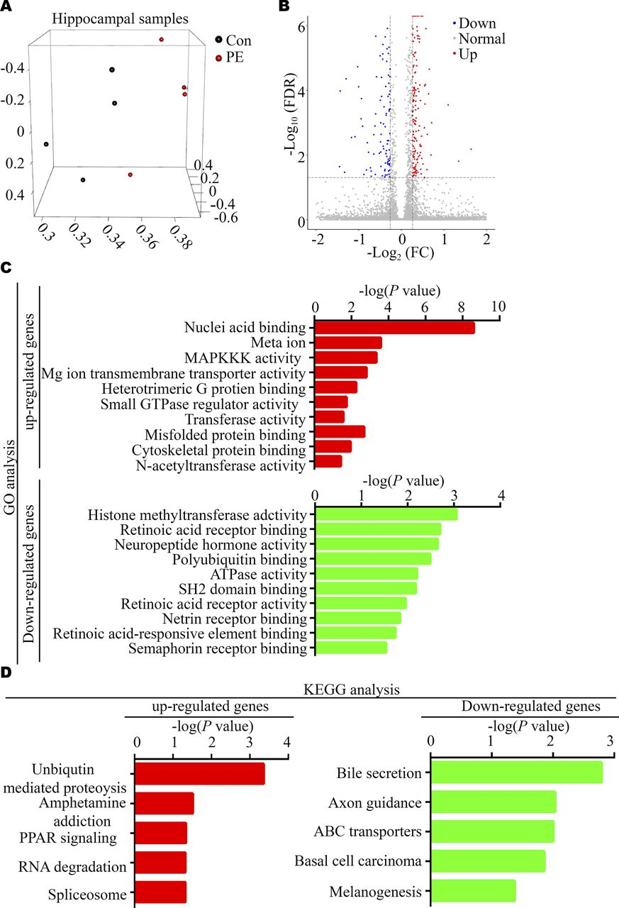
Adult PE offspring have differentially expressed genes (DEGs) in their cortices that could explain autism-like behaviors
317 DEGs :
- 108 down-regulated
+ 209 up-regulated,
compared to control samples
Up-regulated DEGs strongly involved in RNA processing

Slide 9

My project aims

Slide 10
Aim 1
See if can reproduce original findings regarding differentially expressed genes
Aim 4 (?)
Classification ML model based on gene expression and splicing profiles
If unrealistic with n=4: see if can find any similar studies
Aim 2
Expand study by analyzing transcripts that are differentially spliced between control and PE pups
Andreas’s suggestion: scoring system for PE outcome severity in terms of ASD symptoms
Andreas’s suggestion: follow-up questionnaire for PE mothers about potential neurodivergent traits of children (any foundations that pay for this kind of study?)
Aim 3
Interactive Shiny app with input field for gene name and display of gene expression and splicing data
Me: ask Katya Epifanova if anamnesis of mothers of stillborn children has any link to (pre-)eclampsia
Me: anyone else working on autism/neurodivergence who might have info on PE/E in mothers?

Slide 11

My project roadmap and milestones

Slide 12
Before official start
During official internship
Aim 1
See if can reproduce original findings regarding differentially expressed genes
Aim 2
Expand study by analyzing transcripts that are differentially spliced between control and PE pups
Aim 3
Interactive Shiny app with input field for gene name and display of gene expression and splicing data
Aim 4 (?)
Classification ML model based on gene expression and splicing profiles
If unrealistic with n=4: see if can find any similar studies
CW 30
(22.7.-28.7.)
CW 31
(29.7.-4.8.)
CW 32
(5.8.-11.8.)
CW 33
(12.8.-18.8.)
CW 34
(19.8.-25.8.)
CW 38
(16.9.-22.9.)
vacation
CW 35
(26.8.-1.9.)
CW 36
(2.9.-8.9.)
CW 37
(9.9.-15.9.)
CW 39
(23.9.-29.9.)
CW 40
(30.9.-6.10.)

Slide 13


What done so far

Slide 14
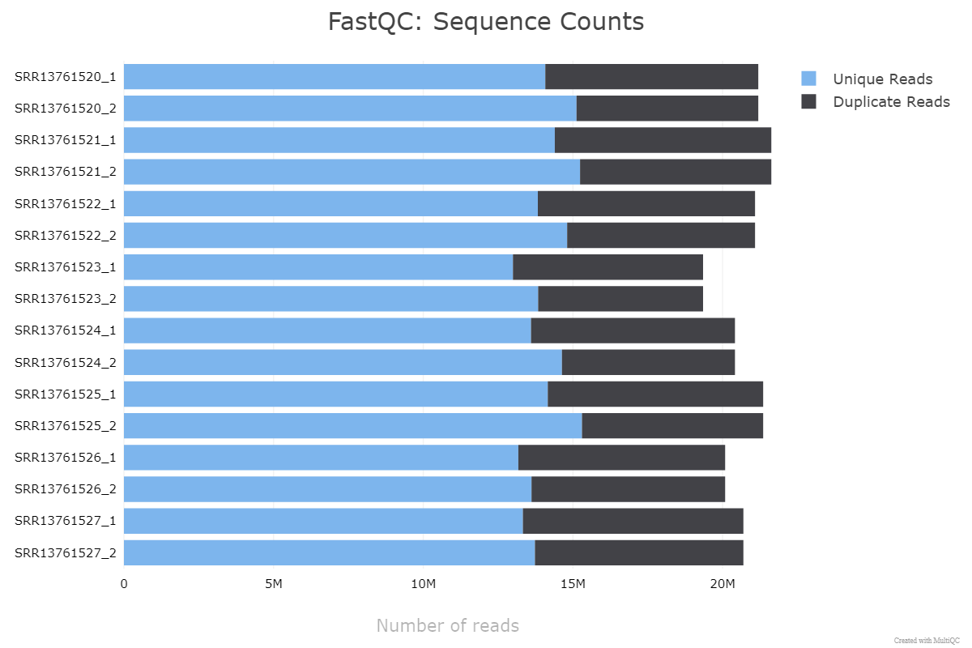
Data retrieval, unpacking, checking for integrity and quality

Slide 15
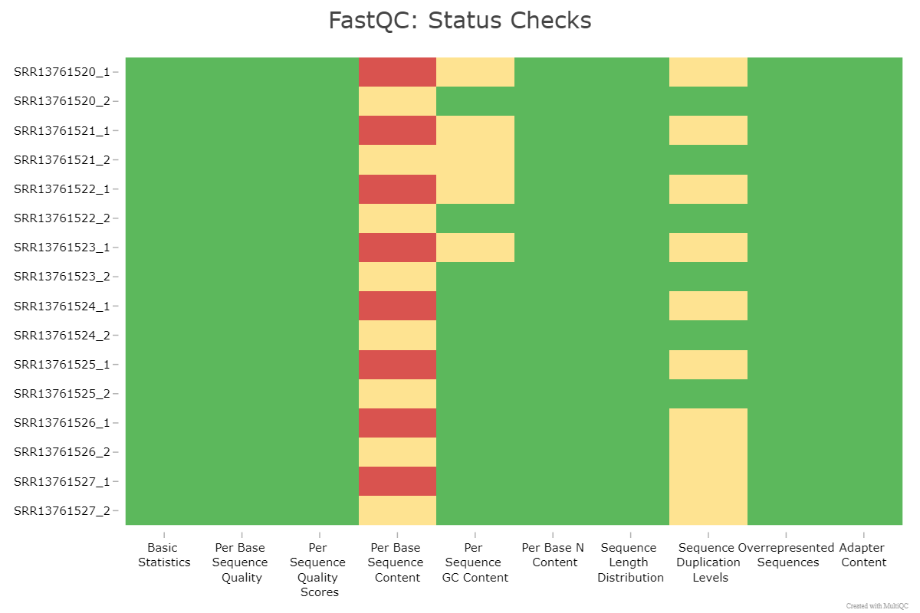
Data retrieval, unpacking, checking for integrity and quality

Slide 16
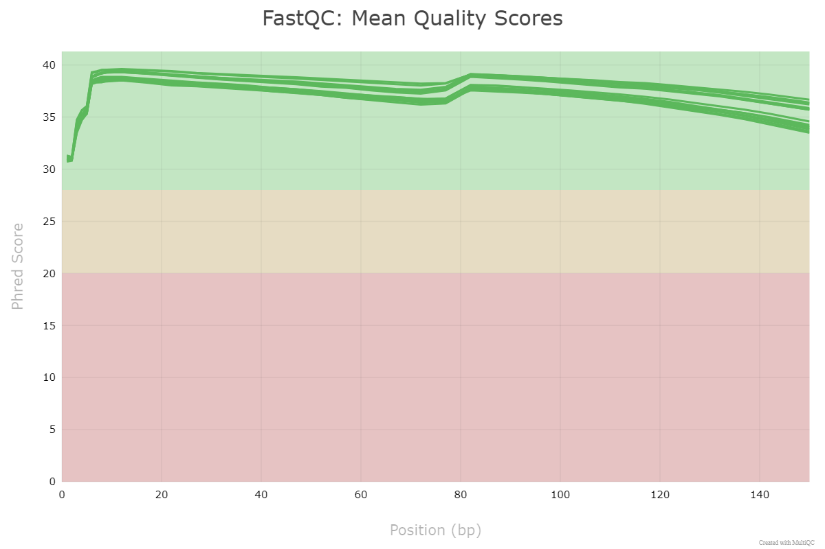
Data retrieval, unpacking, checking for integrity and quality

Slide 17
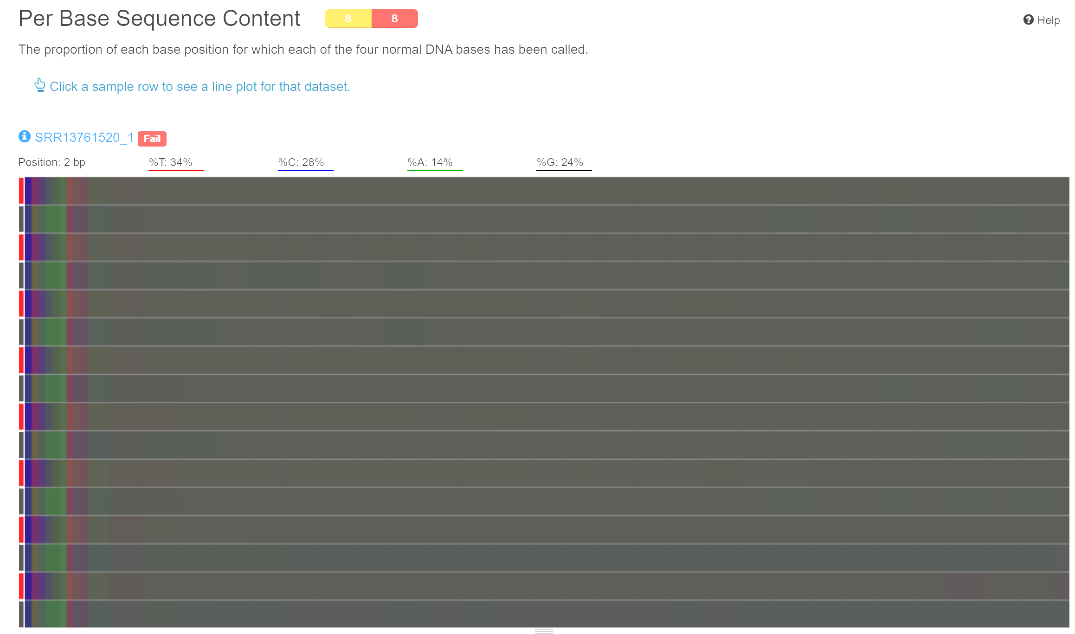
Data retrieval, unpacking, checking for integrity and quality
normal to have some bias, especially in the beginning of the read → which part to cut from all reads

Slide 18

Steps until next meeting

Slide 19
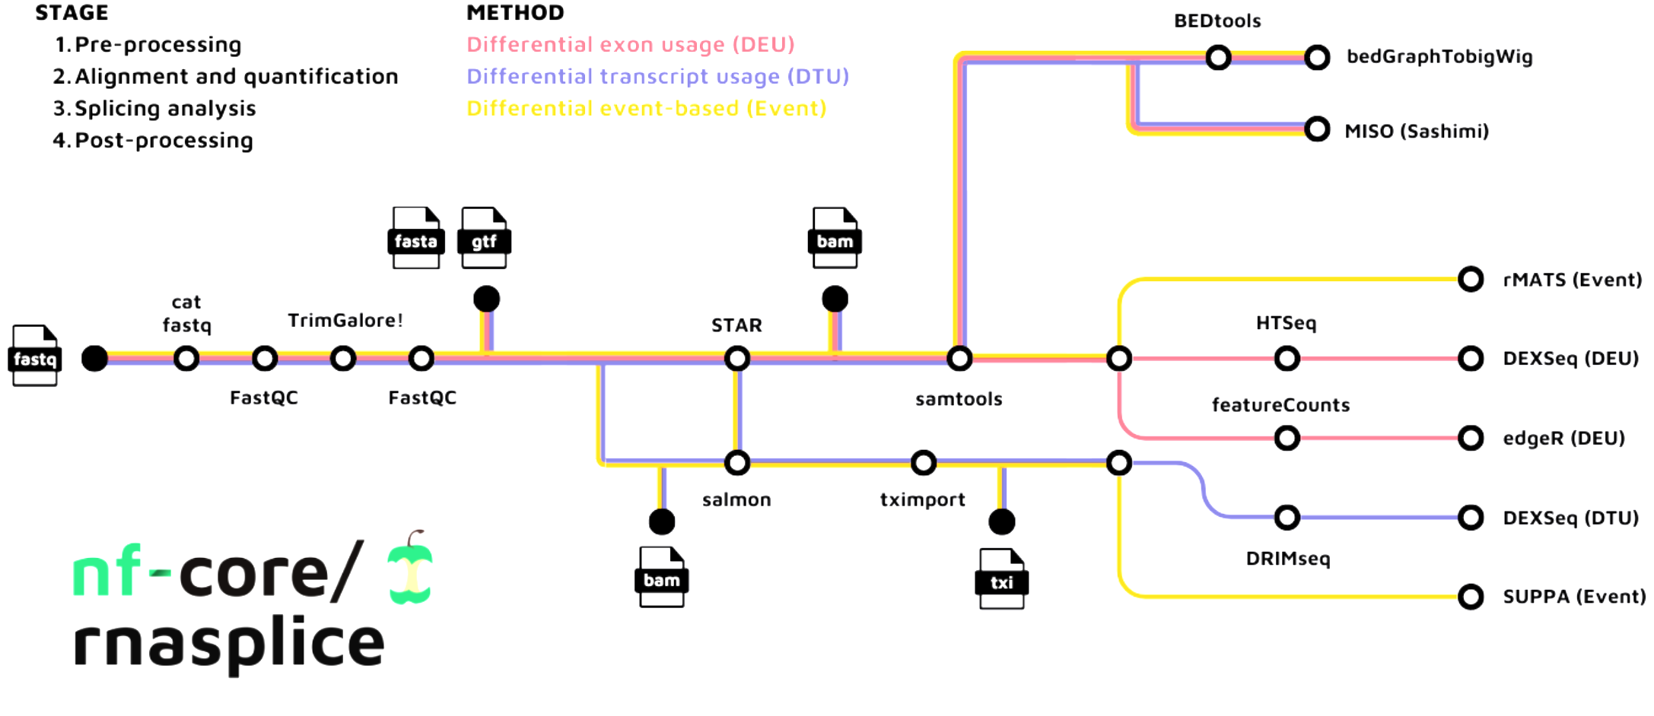
Depending on when we next meet
Trimming parts of reads that don’t meet highest quality criteria
Map reads to the mouse genome
Run Nextflow rnasplice pipeline for analyzing gene expression and alternative splicing
Research how others made comparable Shiny apps, e.g. “Cortexomics” and others on MDC server

Slide 20

Improving stats book

Slide 21
Already worked on some things during course
Lots of comments in chunks of code to better explain what each part of script does
Changed naming of some variables to make it easier to run parts of script independent of one another
Minor changes on some of the graphs
Edited some of the explanatory text

Slide 22
What to still do?
Separate chunks of code better to allow individual running
Transform separate R scripts, e.g. for LM, ML, etc, into Quarto documents
What figure changes desired?
Andreas’s wishes:
stick to separation of code chunks
Go through stats slides and see which figures could use updating. Change the ones based on accessible data, flag the ones that are based on confidential data

Slide 23

Expectations

Slide 24
How does a successful internship look like in your eyes?
Frequency of communication
Communicating changes in the timeline
Frequency of results
End products – minimum viable product, dream product
Insert your expectations here ☺:
1
2
3

